Slide 1

AI WEBSCRAPER USING VOICE COMMAND
A PRESENTATION DONE BY
TAMILARASAN .R
230282601121
UNDER THE GUIDANCE OF
Mrs.T.PANDIYAVATHI
ASSISTANT PROFESSOR (Senior Grade)
MASTER OF COMPUTER APPLICATIONS (2023-2025)
DEPARTMENT OF COMPUTER APPLICATIONS

Slide 2

ROAD MAP
Abstract
Objective of the Project
Literature Survey
Existing System
Problem Identify
Proposed System
Architecture Diagram
Module Implementation
Conclusion and Future Enhancement
Certificate
TECHNOLOGY / TOOLS IDENTIFIED FOR DEVELOPMENT
Reference
Thank You
DEPARTMENT OF COMPUTER APPLICATIONS

Slide 3
ABSTRACT
This project introduces an AI-powered web scraper controlled by voice commands, enabling users to extract information from websites efficiently and hands-free.
Develop an AI-powered web scraper that operates using voice commands, enabling hands-free and efficient data extraction from websites
The integration of voice-based interaction enhances accessibility, making web scraping more intuitive for users with limited technical expertise.
The proposed solution leverages artificial intelligence (AI) and web scraping techniques to provide an intuitive and responsive user experience, reducing manual effort and improving data accessibility.
DEPARTMENT OF COMPUTER APPLICATIONS

Slide 4
OBJECTIVE
Enable Hands-Free Web Scraping – Implement voice commands to initiate and control web scraping tasks, reducing manual effort.
Integrate AI for Query Understanding – Use Natural Language Processing (NLP) to interpret user speech and convert it into structured web scraping requests.
Automate Data Extraction and Processing – Employ web scraping frameworks like BeautifulSoup, Scrapy, or Selenium to fetch and refine relevant data.
Improve Accessibility and User Experience – Make data retrieval easier for visually impaired individuals and professionals handling large datasets.
DEPARTMENT OF COMPUTER APPLICATIONS

Slide 5
LITERTURE SURVEY
TITLE | ABSTRACT | YEAR OF PUBLISH | AUTHOR | LIMITATIONS
Importance of Web Scraping as a Data Source for Machine Learning Algorithms - Review | Highlights how web scraping plays a crucial role in collecting data for machine learning models. Discusses challenges like anti-scraping mechanisms and dynamic webpage structures. | 2022 | IEEE Xplore | SCALABILITY ISSUES
DEPARTMENT OF COMPUTER APPLICATIONS

Slide 6
LITERTURE SURVEY
TITLE | ABSTRACT | YEAR OF PUBLISH | AUTHOR | LIMITATIONS
Enhanced Automated Web Scraping Tool with Proliferation of AI Techniques | Introduces AI-based web scraping techniques, improving adaptability to dynamic websites. Discusses automation in data extraction with minimal human intervention. | 2023 | IEEE EXPLORE | REAL TIME SCRAPING STRUGGLES
DEPARTMENT OF COMPUTER APPLICATIONS

Slide 7
LITERTURE SURVEY
TITLE | ABSTRACT | YEAR OF PUBLISH | AUTHOR | LIMITATIONS
Leveraging Large Language Models for Web Scraping | Explores the use of large language models (LLMs) for web scraping, enabling better understanding of website structures and user queries. | 2024 | Ahluwalia, A., & Wani, S. | ADAPTIVE SCRAPING STILL IN EARLY STAGES
DEPARTMENT OF COMPUTER APPLICATIONS

Slide 8
Existing System
Most web scrapers require users to input search queries and extraction parameters manually via a command-line interface (CLI) or graphical user interface (GUI).
Traditional scrapers follow predefined rules and lack flexibility in adapting to dynamic websites with changing layouts.
Web scraping typically involves keyboard and mouse inputs, making it less efficient for multitasking or accessibility-focused applications.
DEPARTMENT OF COMPUTER APPLICATIONS

Slide 9
PROBLEM IDENTIFIED
Lack of Accessibility: Existing tools are not user-friendly for non-technical users.
Manual Effort: Users must manually search, copy-paste, and format data.
Rigid Functionality: Traditional scrapers are not flexible to adapt to various user intents.
No Natural Language Interface: Users cannot interact with scrapers using voice or text in natural language.
DEPARTMENT OF COMPUTER APPLICATIONS

Slide 10
PROPOSED SYSTEM
Voice commands allow for faster query input compared to manual text-based commands
AI-based voice recognition minimizes typographical errors common in manual input.
Users can instantly access and refine web data extraction through voice feedback loops.
Users receive extracted data in real time, with options to refine searches through additional voice commands.
DEPARTMENT OF COMPUTER APPLICATIONS

Slide 11
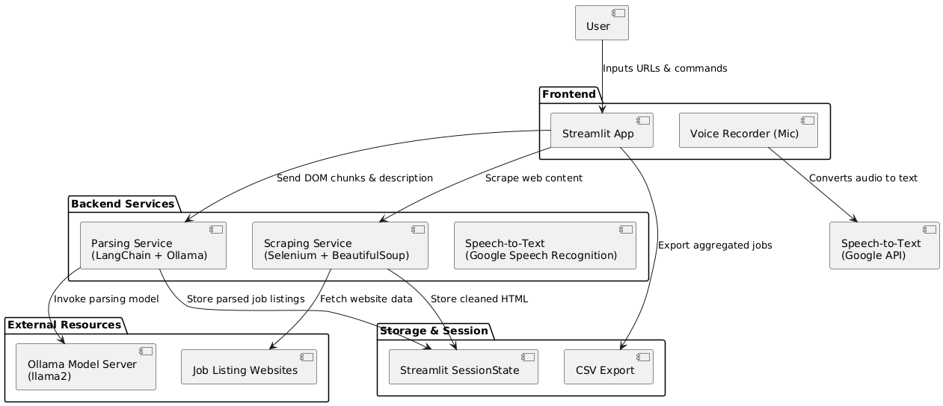
ARCHITECTURE DIAGRAM
DEPARTMENT OF COMPUTER APPLICATIONS

Slide 12
MODULE IMPLEMENTATION
Module 1 : Captures user voice input and converts it into text.
The user speaks a query (e.g., "Search for the latest AI trends").
The system processes the audio and converts it into text.
The recognized text is passed to the next module for search query processing.
Module 2 : Transforms the recognized speech text into a structured search query.
The system receives the recognized text (e.g., “latest AI trends”).
It converts it into a URL format like https://www.google.com/search?q=latest+AI+trends.
The structured query is then forwarded to the web scraping module.
DEPARTMENT OF COMPUTER APPLICATIONS

Slide 13
MODULE IMPLEMENTATION
Module 3 : Extracts relevant information from search results or specific websites.
The search query is sent to the search engine, and results are retrieved.
The scraper extracts top search results and relevant details.
The extracted data is structured and passed to the response module.
Module 4 : Presents the scraped results in text format or reads them aloud using text-to-speech (TTS).
The extracted search results are formatted for display.
The system presents them as text on the screen.
Optionally, it reads the results aloud using AI-based text-to-speech.
DEPARTMENT OF COMPUTER APPLICATIONS

Slide 14
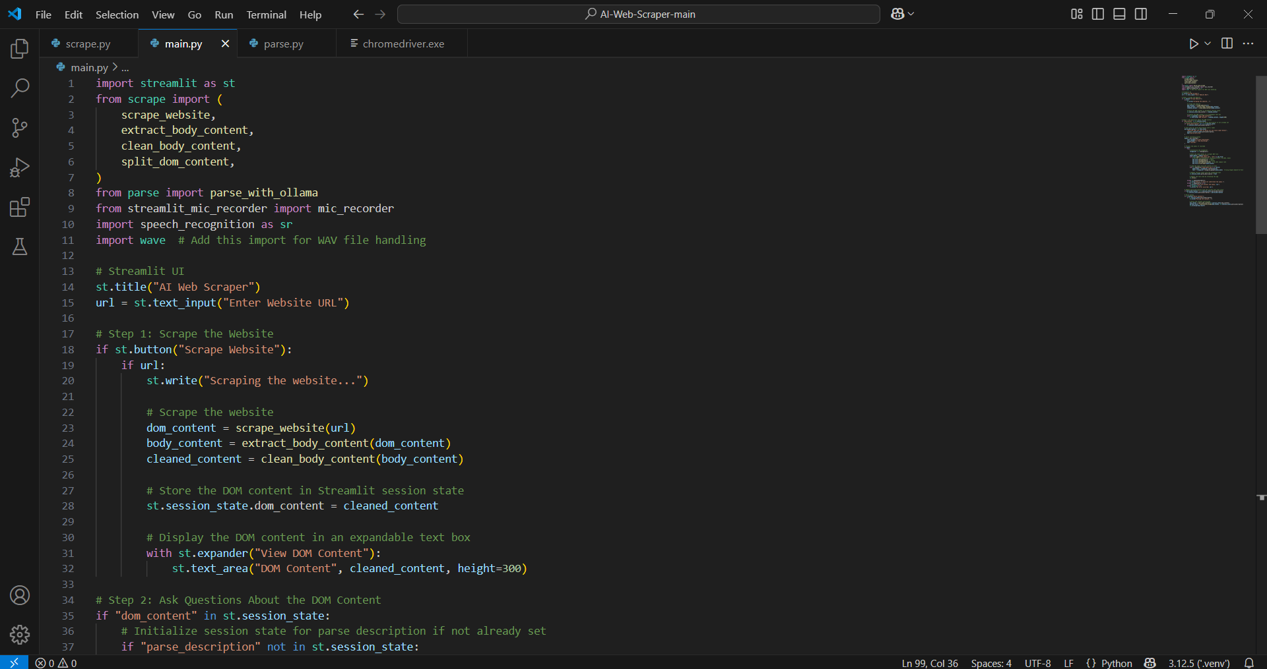
CODE IMPLEMENTATION
DEPARTMENT OF COMPUTER APPLICATIONS

Slide 15
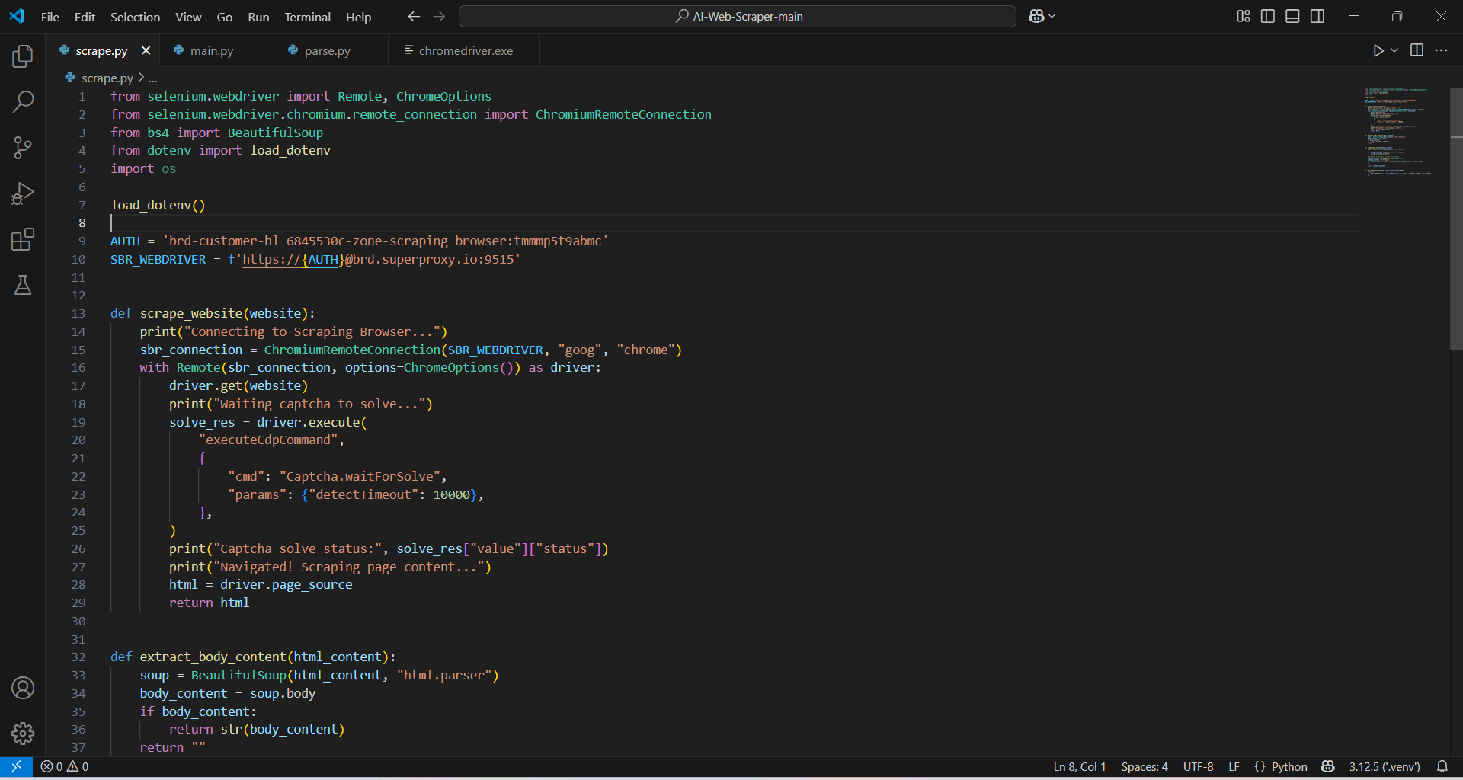
CODE IMPLEMENTATION
DEPARTMENT OF COMPUTER APPLICATIONS

Slide 16
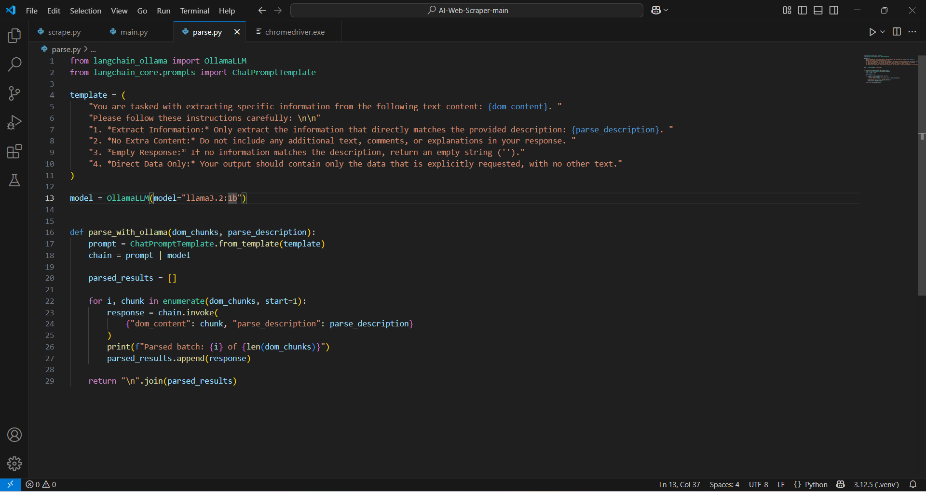
MOULE IMPLEMENTATION
DEPARTMENT OF COMPUTER APPLICATIONS

Slide 17
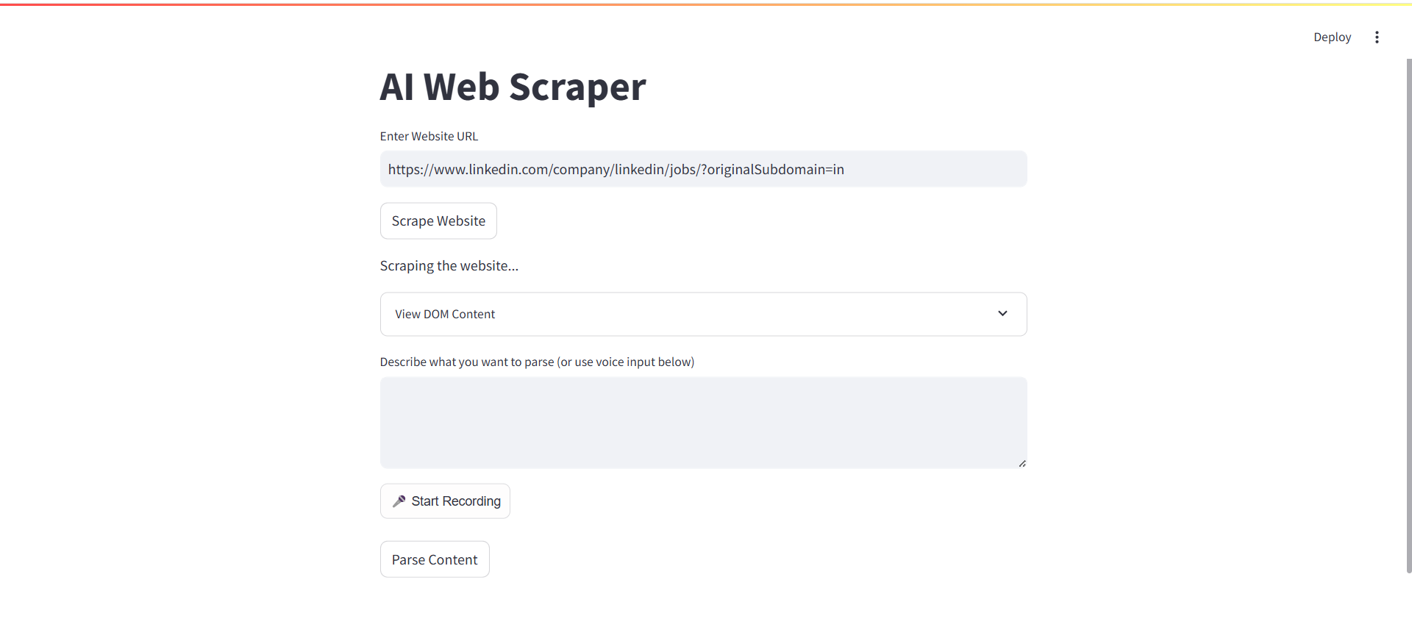
MODULE IMPLEMENTATION
DEPARTMENT OF COMPUTER APPLICATIONS

Slide 18
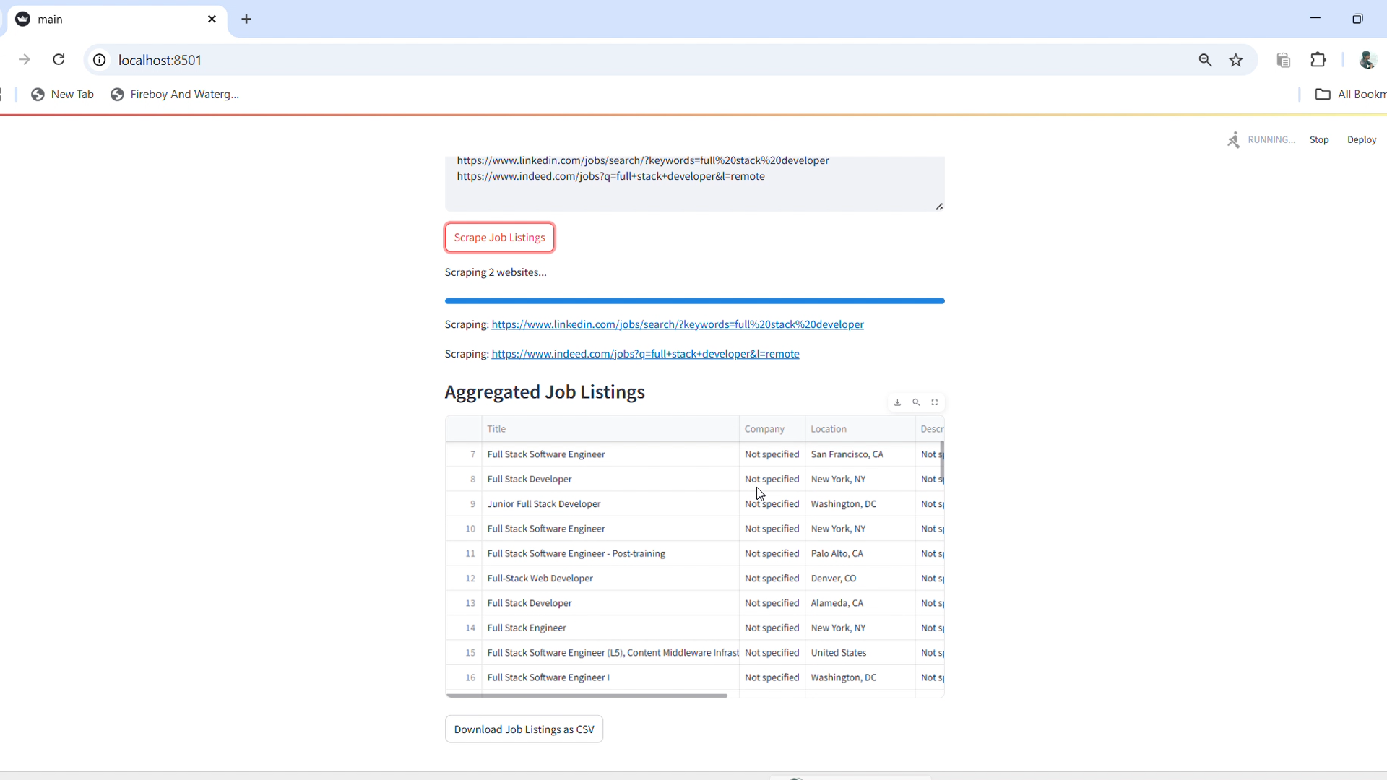
MODULE IMPLEMENTATION
DEPARTMENT OF COMPUTER APPLICATIONS

Slide 19
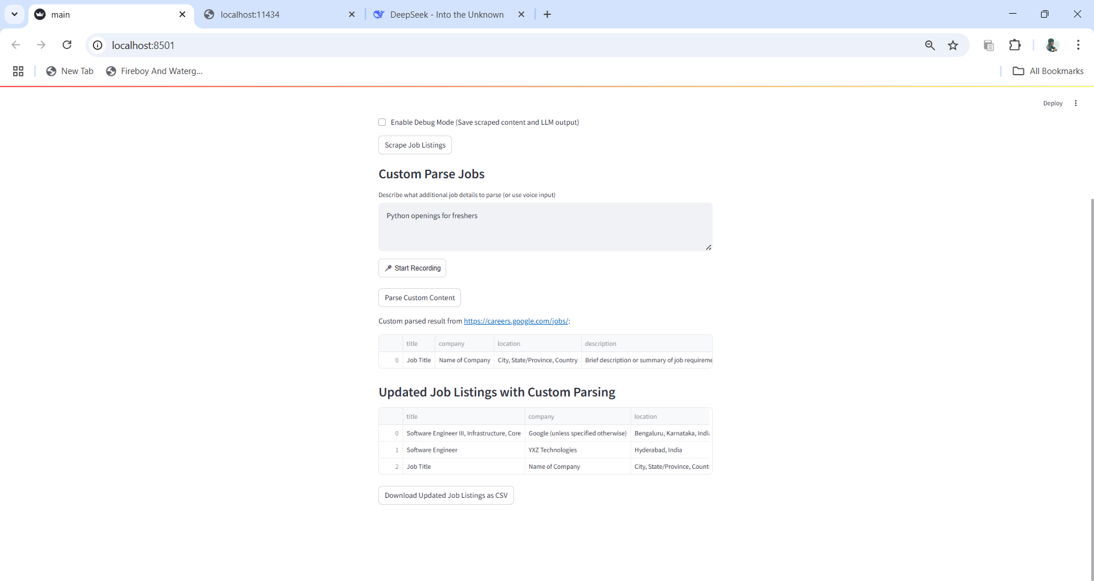
MODULE IMPLEMENTATION
DEPARTMENT OF COMPUTER APPLICATIONS

Slide 20
Conclusion and Future Enhancement
Successfully developed an AI-powered voice-based web scraper that combines speech recognition, NLP, and web scraping to automate data retrieval.
Improved accessibility and user experience by enabling hands-free, natural language interaction for non-technical users.
Future improvements include support for multiple languages, better understanding of complex voice queries, and scraping of JavaScript-rendered content using Selenium or Playwright.
Planned enhancements include adding a GUI, voice output via text-to-speech, AI-based summarization of scraped content, and deploying the tool as a cloud-based web/mobile application.
DEPARTMENT OF COMPUTER APPLICATIONS

Slide 21
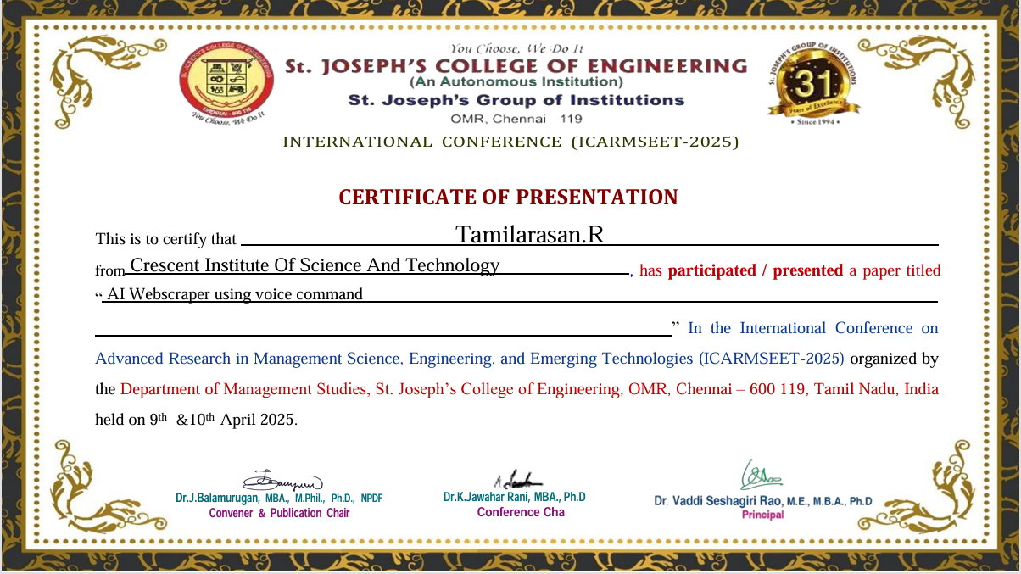
INTERNATIONAL CONFERENCE
DEPARTMENT OF COMPUTER APPLICATIONS

Slide 22
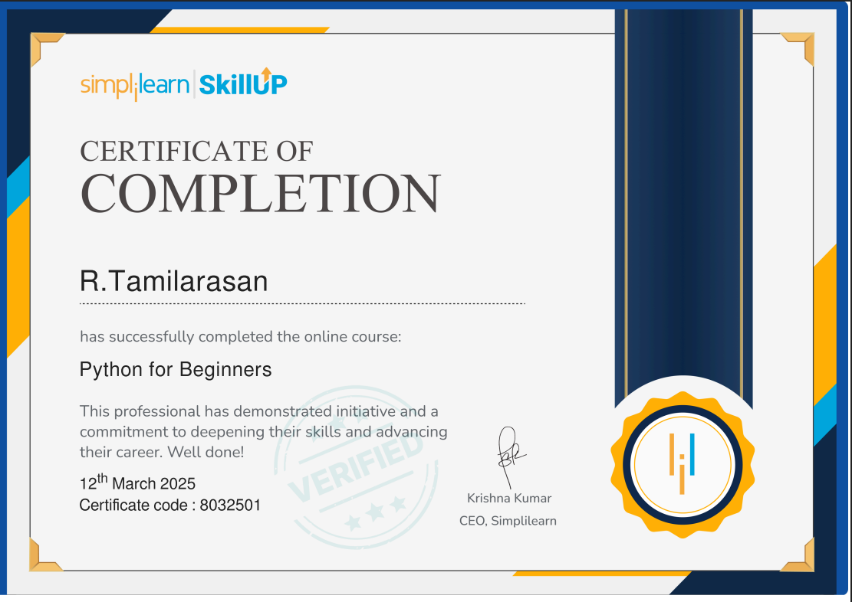
CERTIFICATION
DEPARTMENT OF COMPUTER APPLICATIONS

Slide 23
TECHNOLOGY / TOOLS IDENTIFIED FOR DEVELOPMENT
Hardware
Processor: i5 Processor 11th Gen
RAM: 4GB
Speed: 2.9GHZ
Hard Disk: 500GB
Software
Operating System: Windows 11.
Programming Language: Python using machine learning algorithm
IDE/Code Editors: pychram,jupyter notebook,visual studio
DEPARTMENT OF COMPUTER APPLICATIONS

Slide 24
REFERENCE
Importance of Web Scraping as a Data Source for Machine Learning Algorithms - Review" (2022). ieeexplore.ieee.org
"Enhanced Automated Web Scraping Tool with Proliferation of AI Techniques" (2022). ieeexplore.ieee.org
"AI-Enhanced Web Scraping vs. Conventional Methods" by 4IRE Labs (2023). 4irelabs.com
Leveraging Large Language Models for Web Scraping" by Ahluwalia, A., & Wani, (2024). arxiv.org
DEPARTMENT OF COMPUTER APPLICATIONS

Slide 25

DEPARTMENT OF COMPUTER APPLICATIONS

